Slide 1

Educational application
Perfected By: Team Spirit
TEAM MEMBERS
1.Fathima naseefa
2.Keerthana baby
3.Nikita johny kachappilly

Slide 2


Slide 3


Slide 4


Slide 5


Slide 6
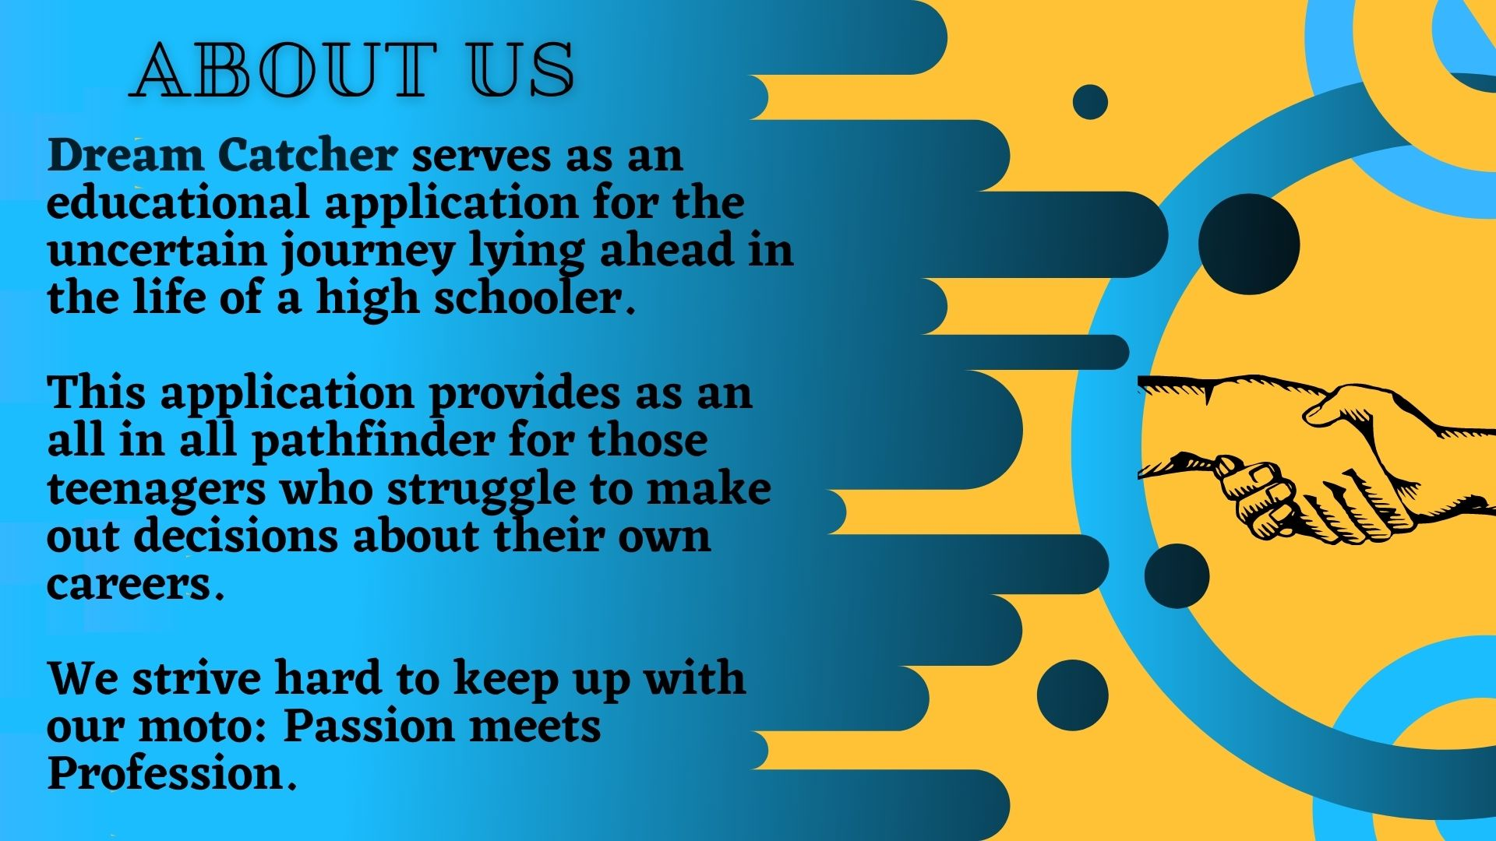

Slide 7
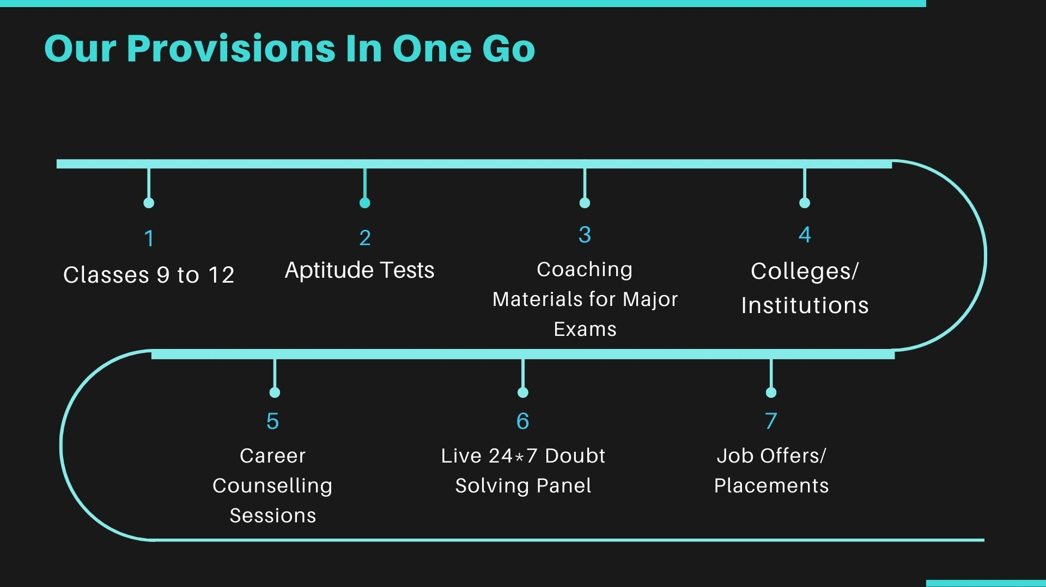

Slide 8


Slide 9
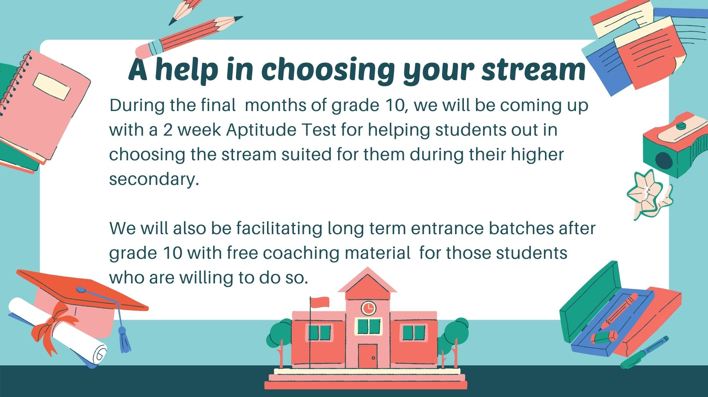

Slide 10
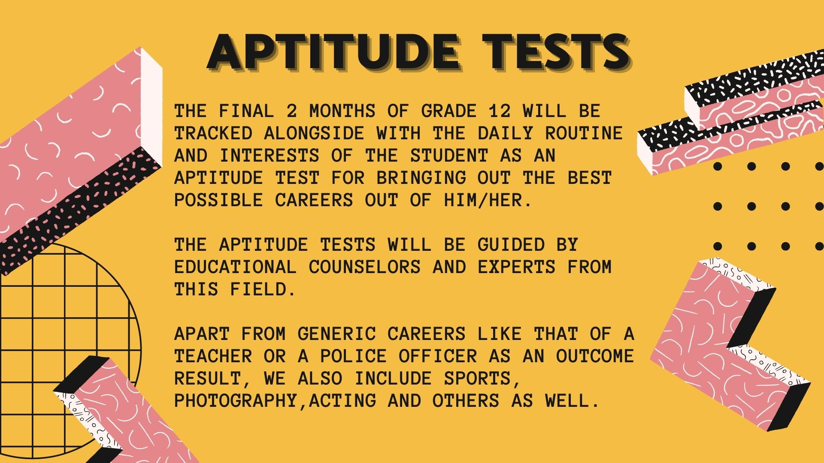

Slide 11
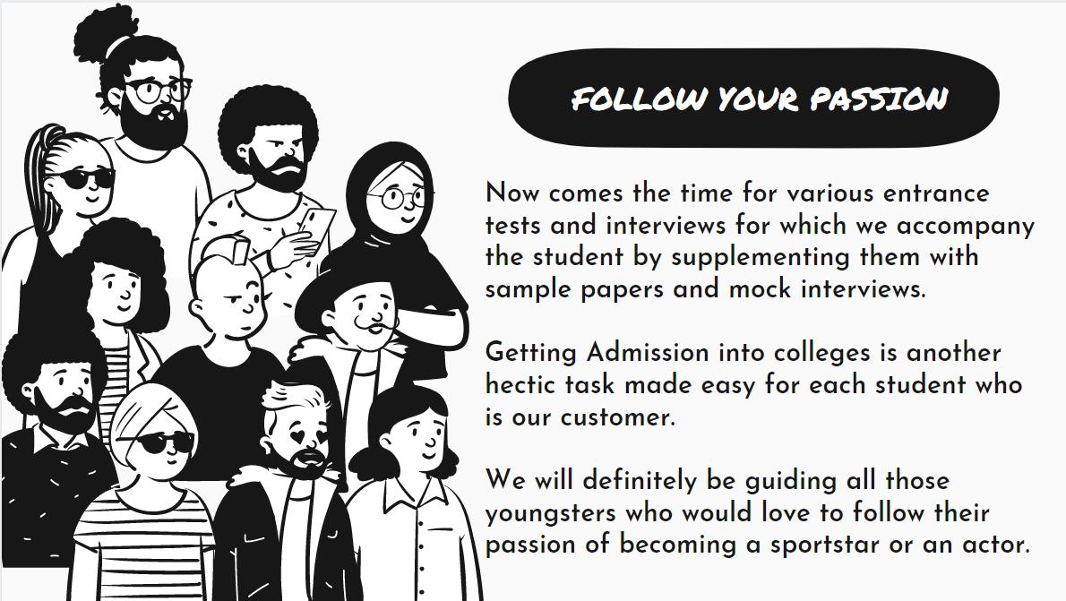

Slide 12


Slide 13



Slide 14


Slide 15
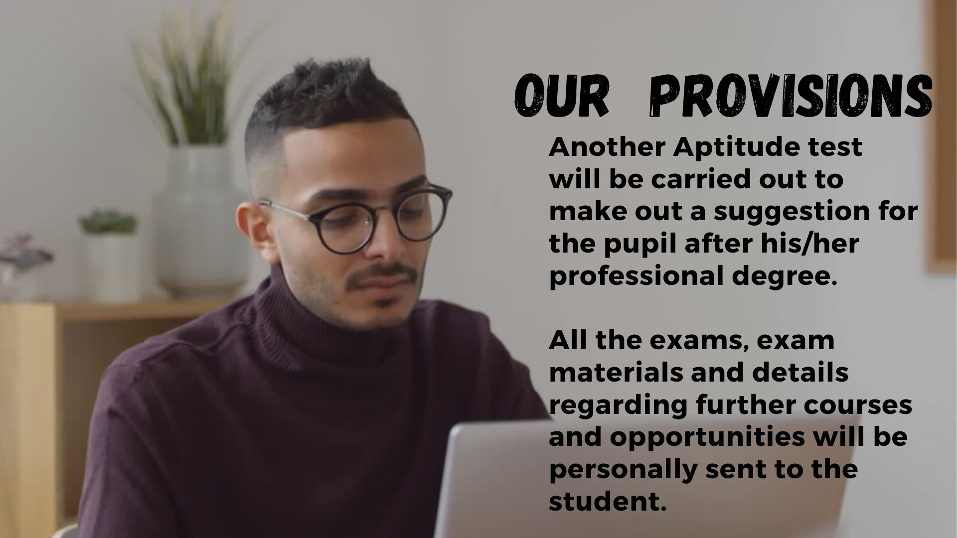

Slide 16
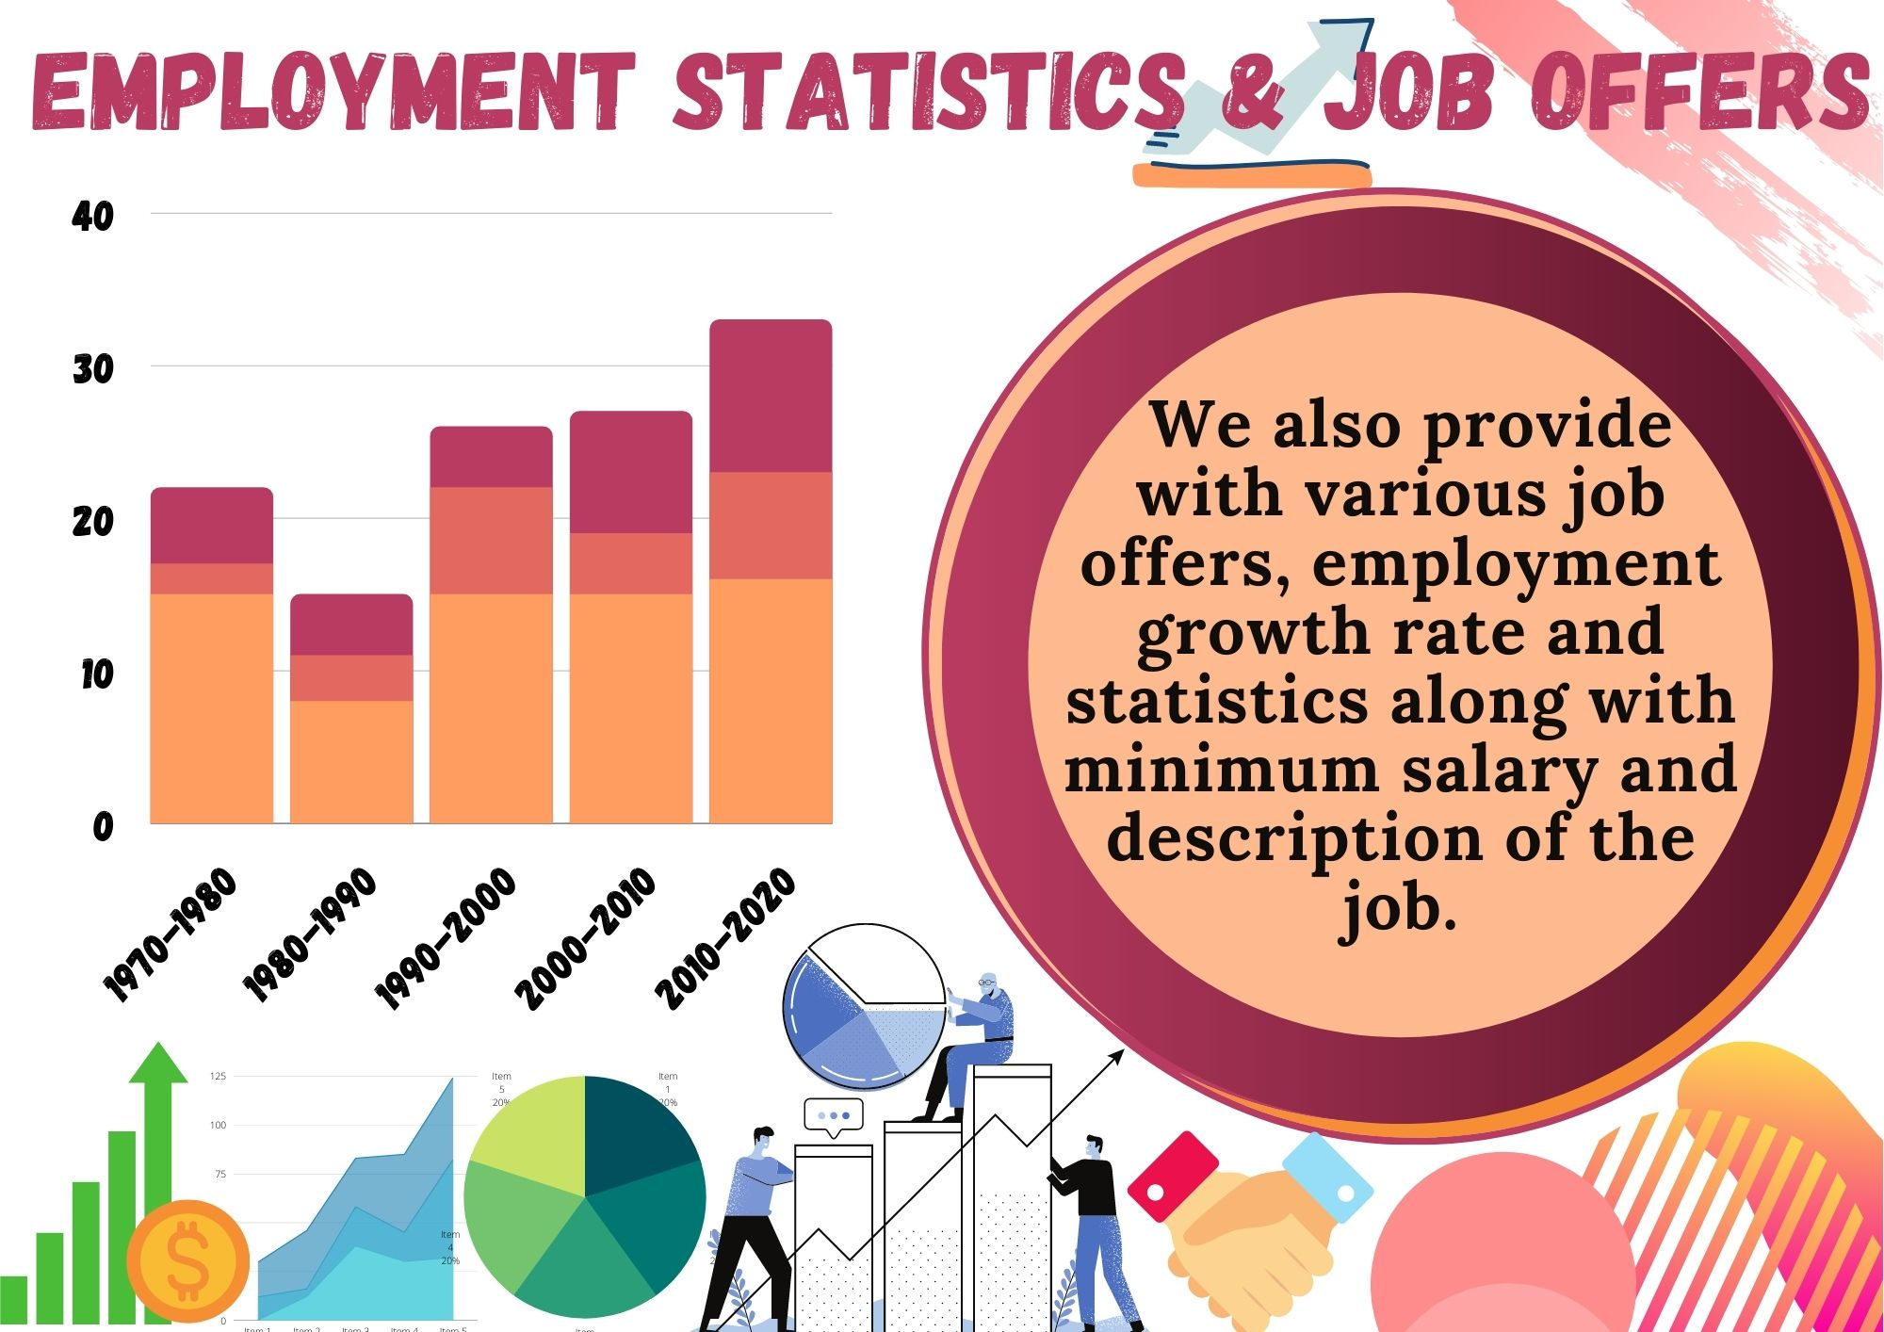

Slide 17


Slide 18


